Slide 1
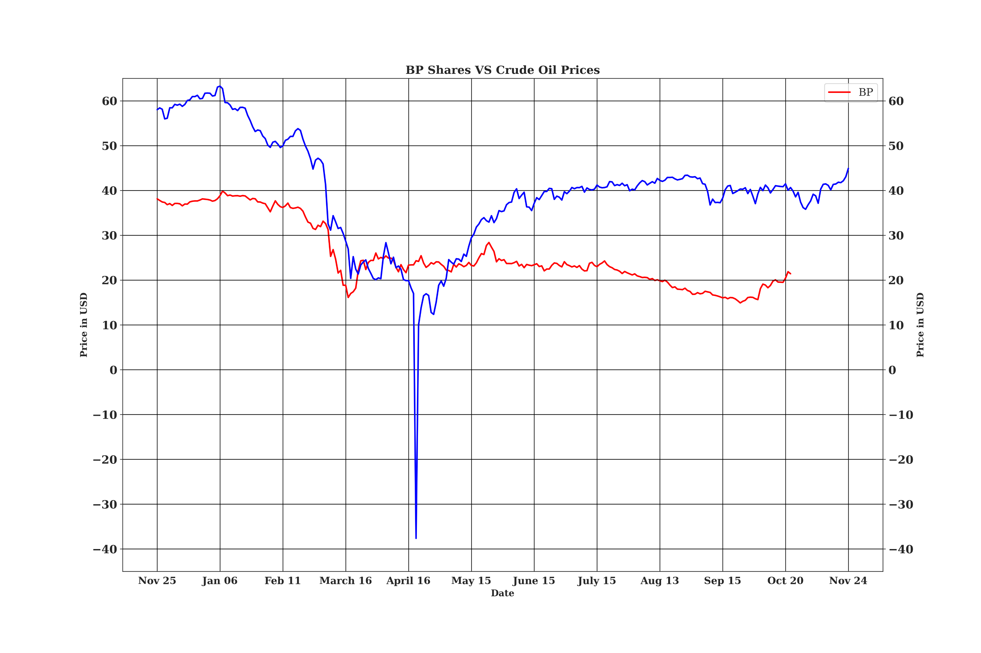
Crude Oil prices vs BP shares

Slide 2
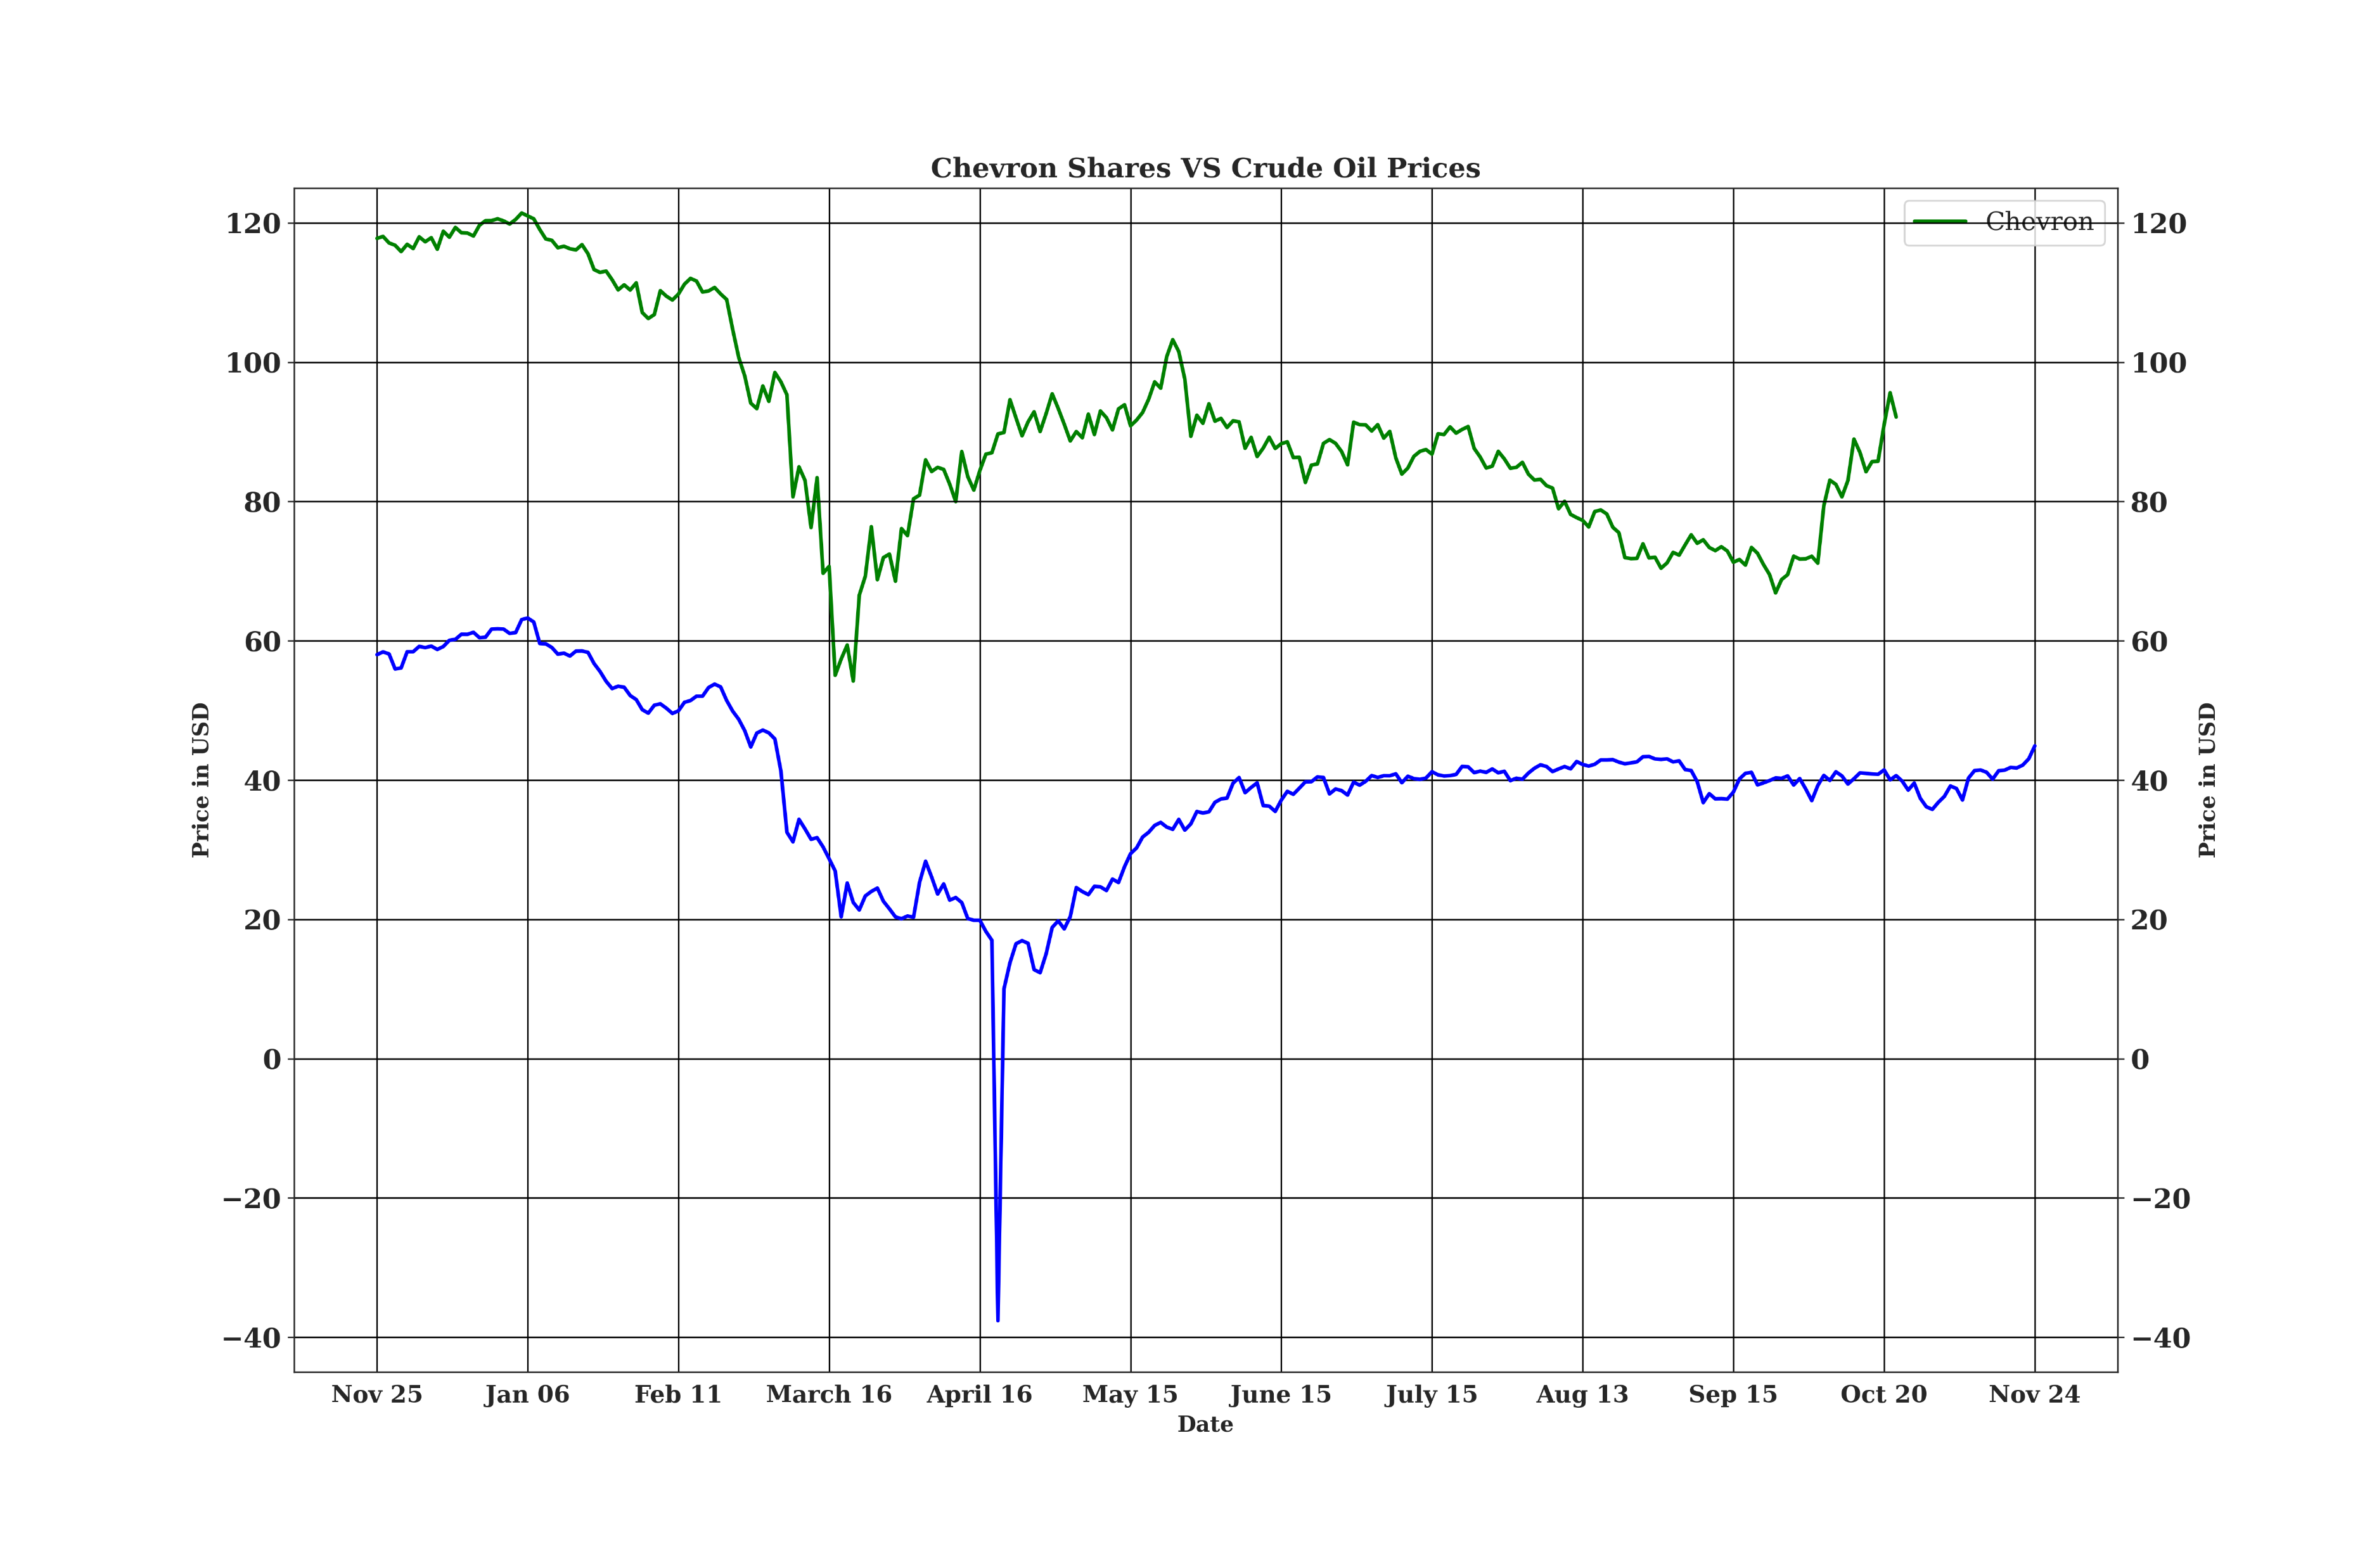
Crude Oil prices vs Chevron shares

Slide 3
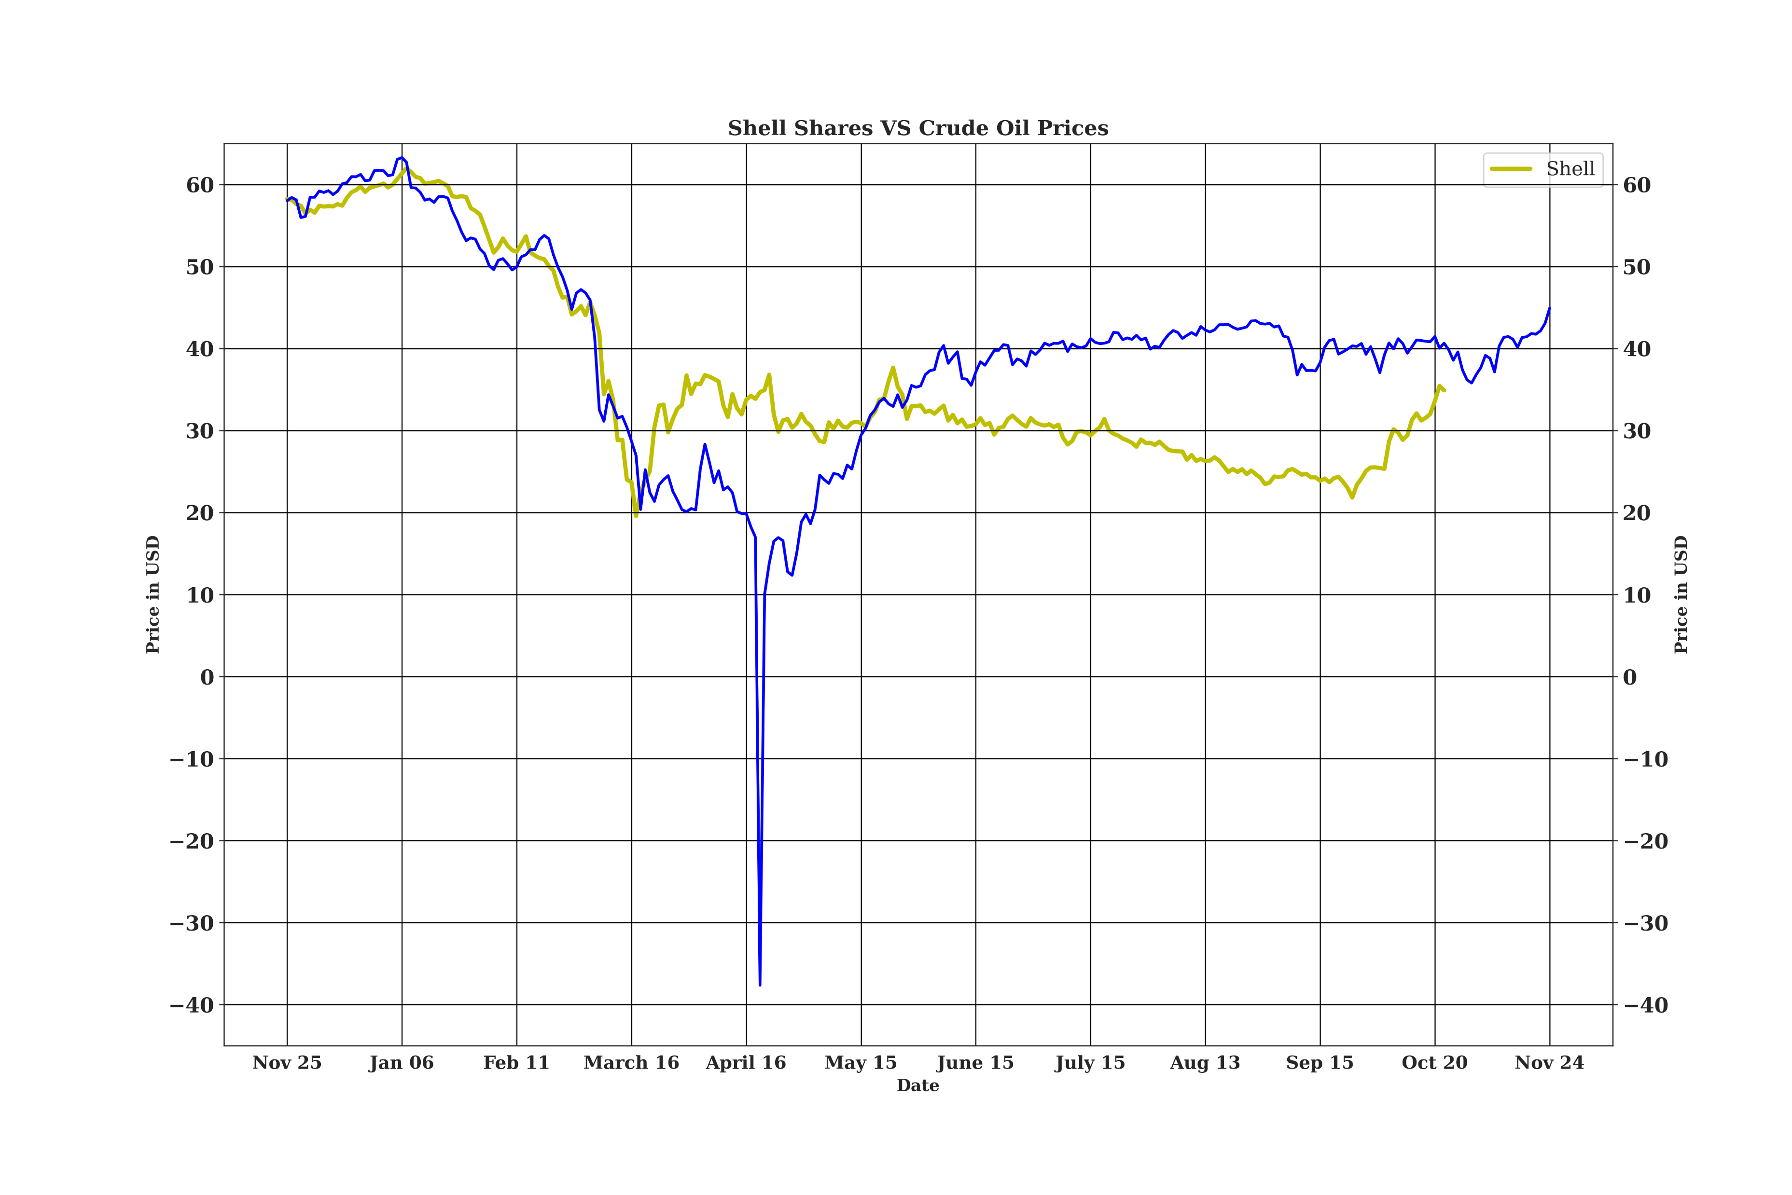
Crude Oil prices vs Shell shares

Slide 4
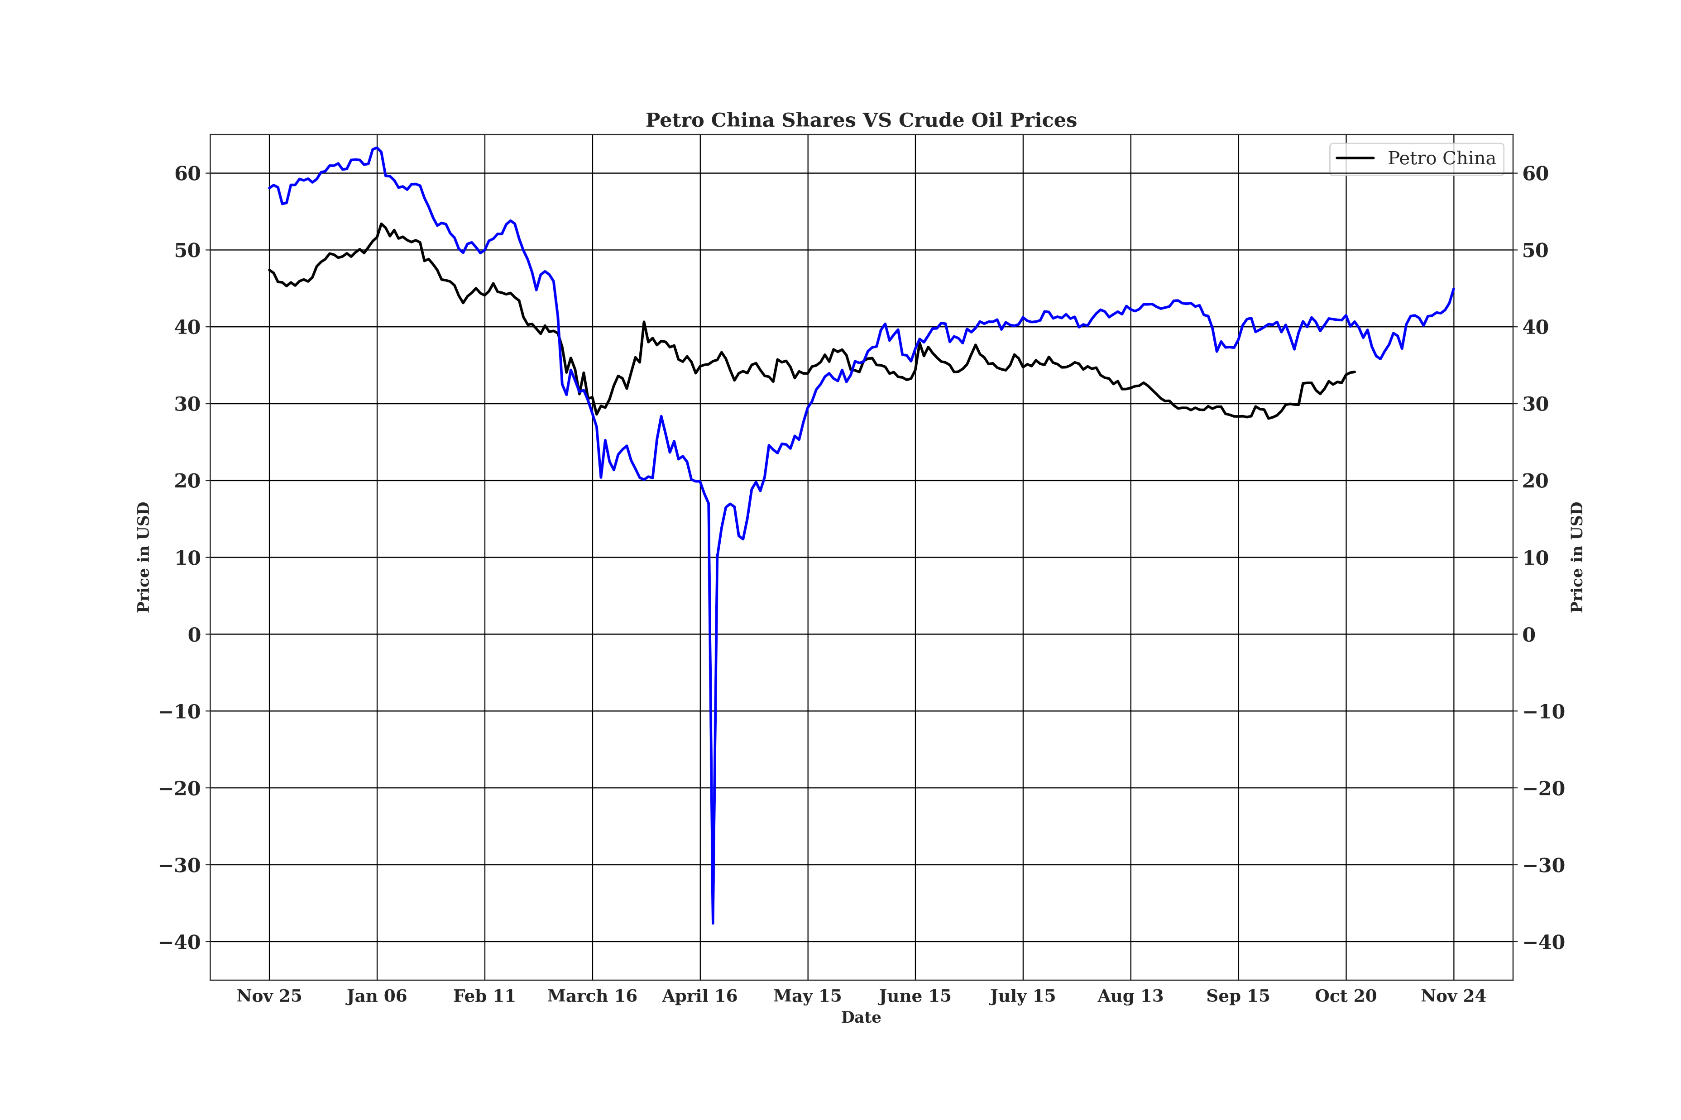
Crude Oil prices vs Petrochina shares

Slide 5
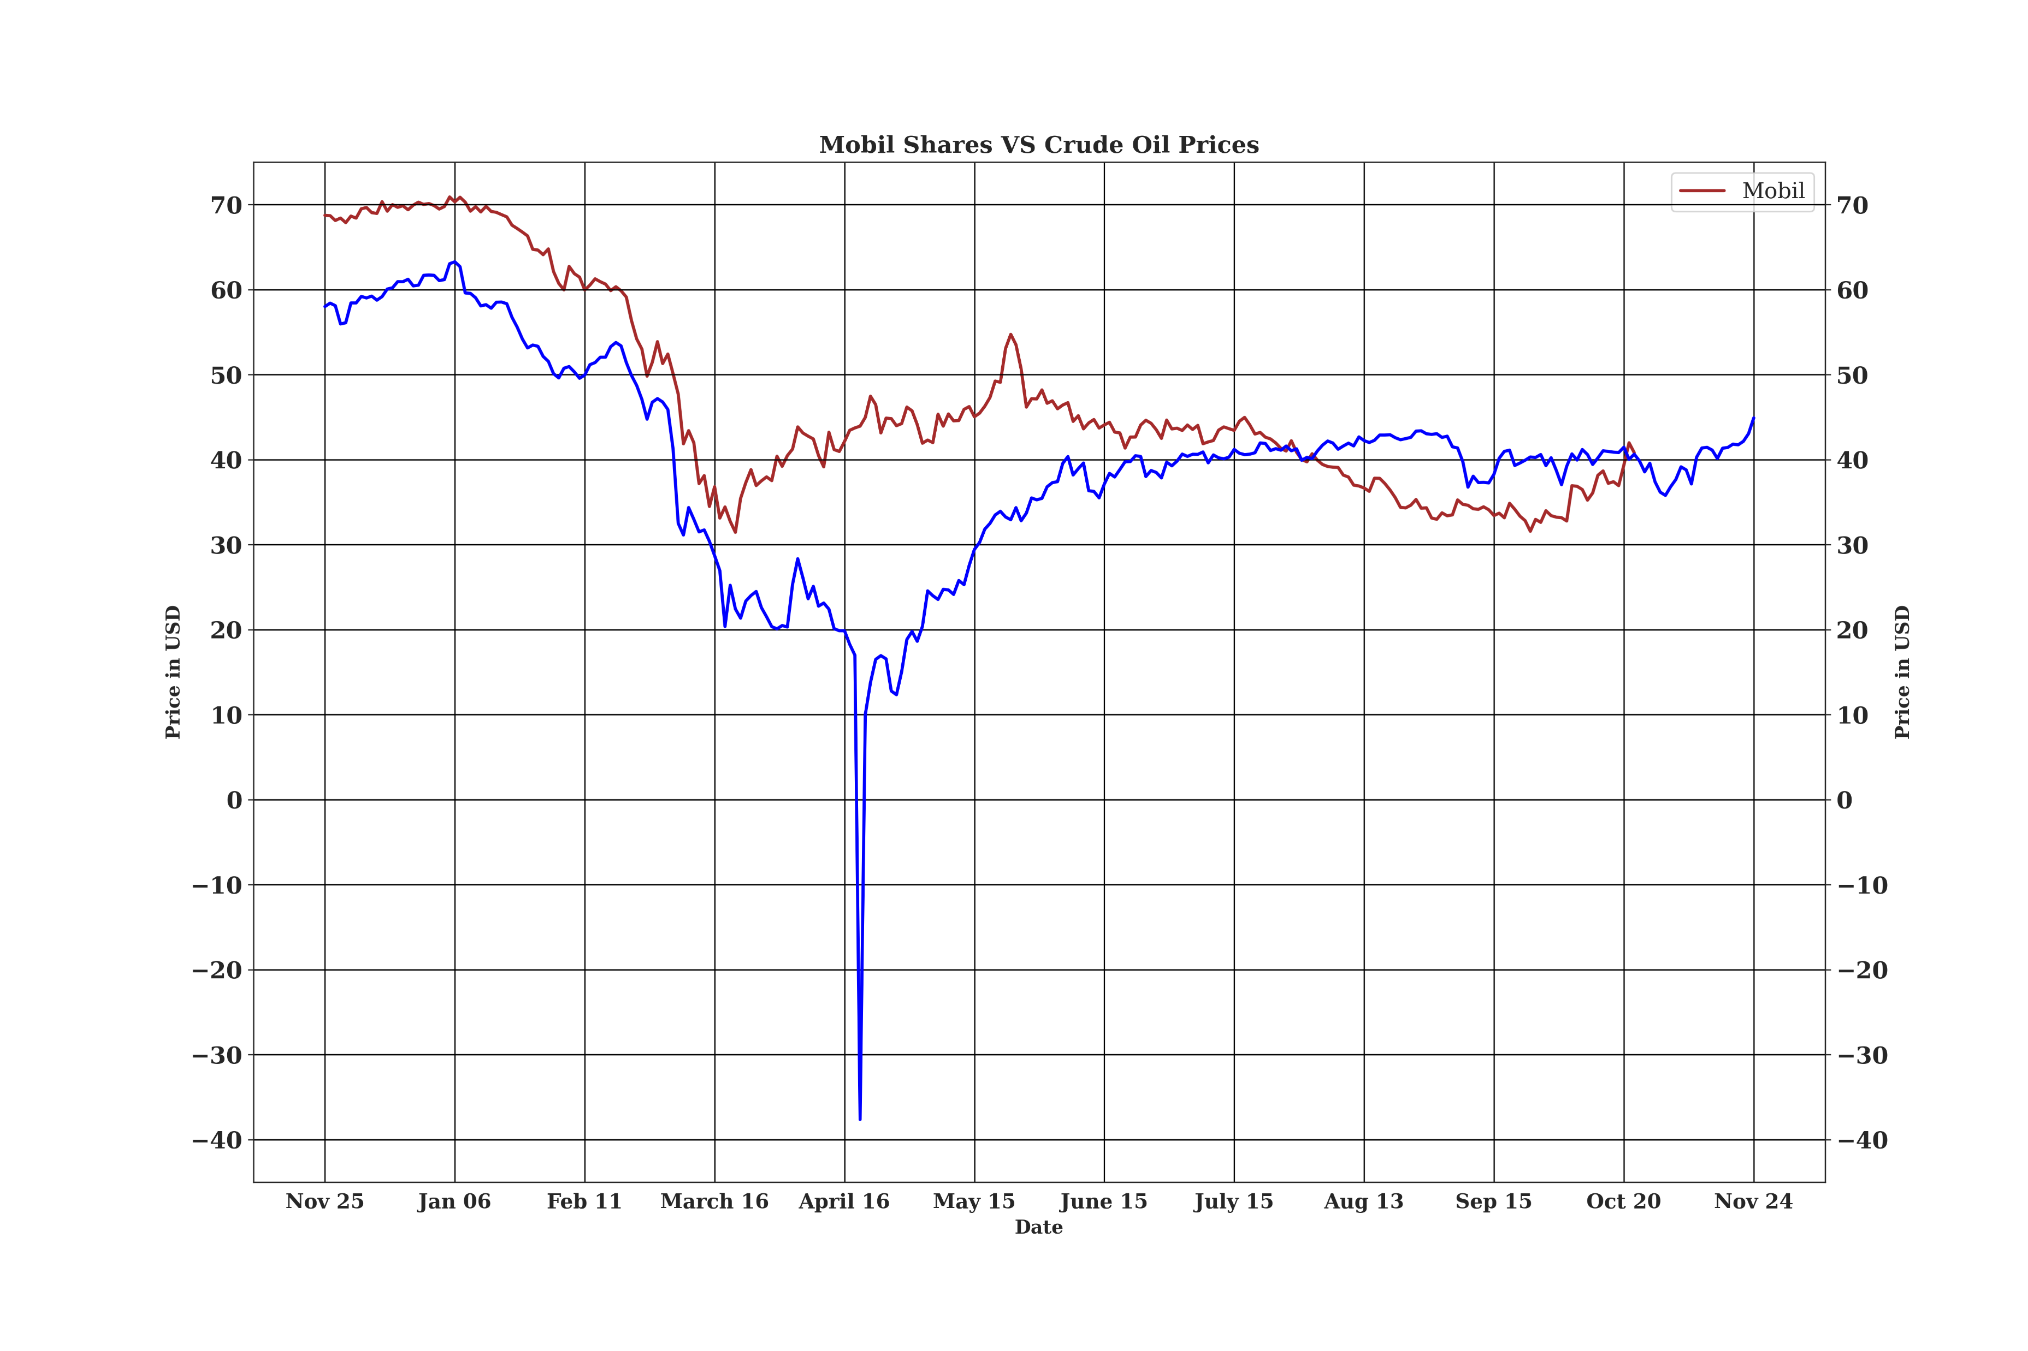
Crude Oil prices vs Mobil shares

Slide 6
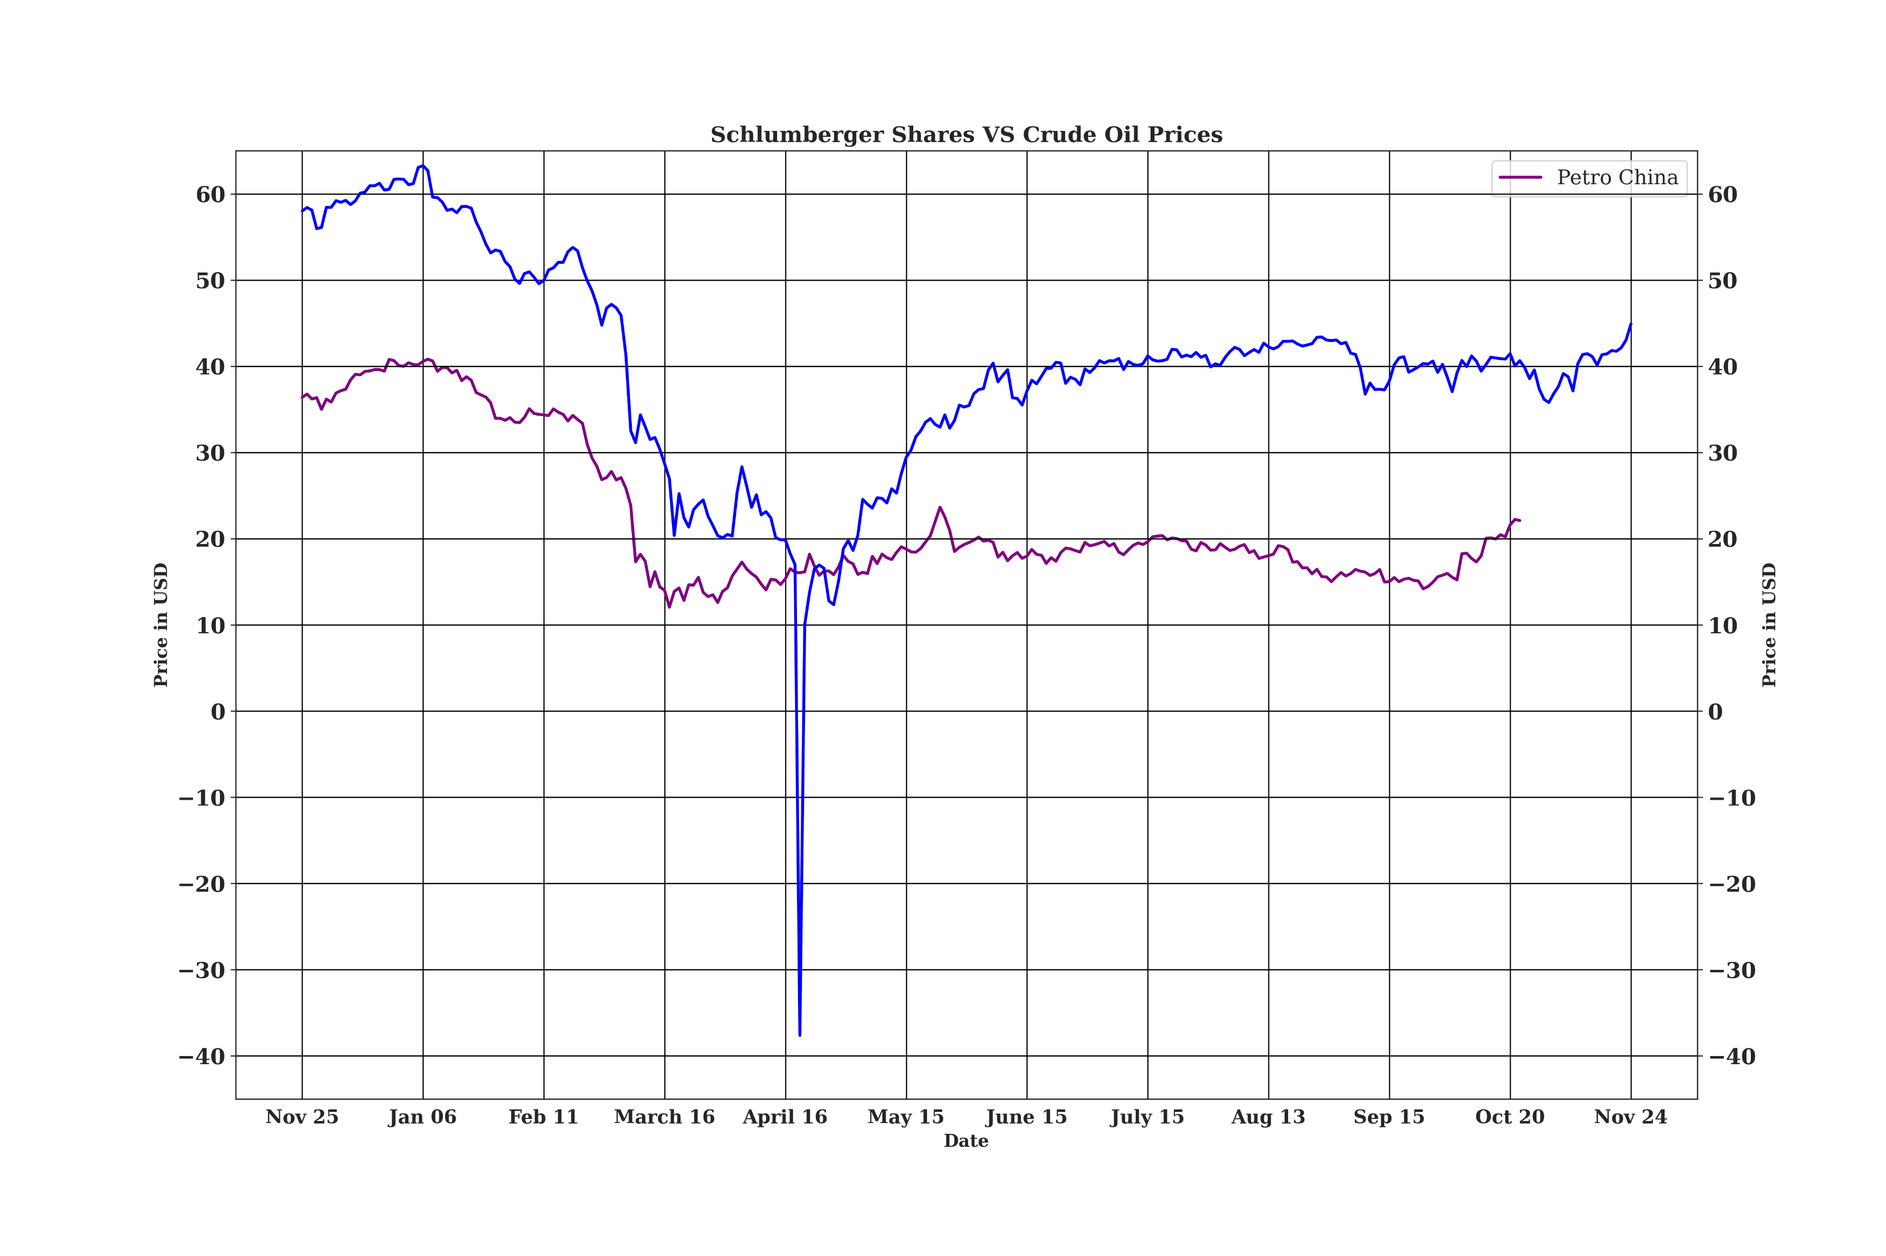
Crude Oil prices vs Schlumberger shares

Slide 7
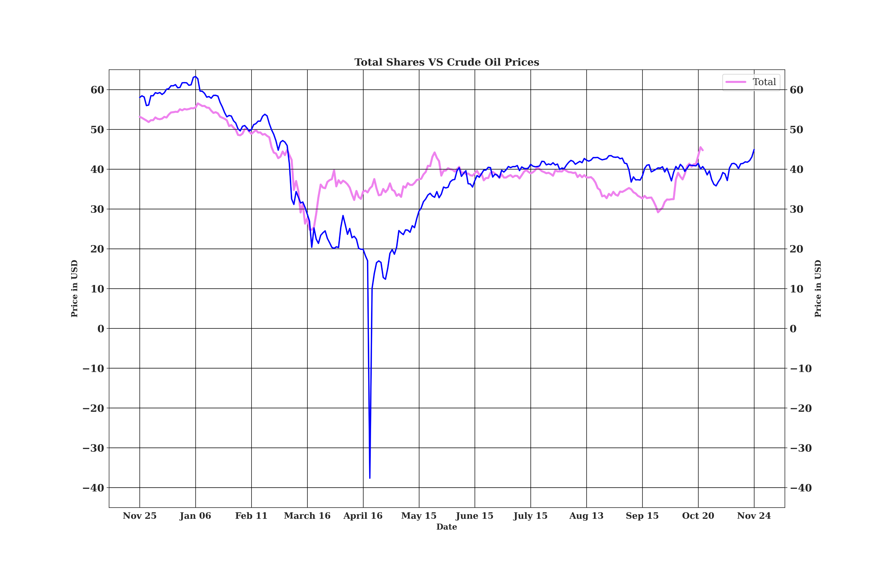
Crude Oil prices vs Total shares

Slide 8
Deductions and Findings
BP shares fell from mid Feb to mid March and rose a little in mid March but didn’t go back to its previous height. This coincided with the initial fall in crude prices.
Chevron shares fell from early Jan to mid March and rose a little in mid March but didn’t go back to its previous height.
Shell shares closely mirrors crude oil prices till mid March when it rises a little and approximately stabilises.
General trend for the shares is to fall till mid March and rise a little and approximately stabilise for all companies except Schlumberger.
The shares don’t go back to their previous highs after the fall.

